Slide 1
UTI Prediction After Initiation of SGLT2 Inhibitor Therapy
Anthony Elkommos Youssef

Slide 2
Introduction
SGLT2 inhibitors are a class of medications commonly used to treat type 2 diabetes, but they have been associated with an increased risk of urinary tract infections (UTIs) in some patients. We leverage deep learning techniques to develop a predictive model that can identify patients at higher risk for UTIs when taking these medications, potentially enabling more personalized monitoring and preventive strategies. This transformer-based model analyzes patient data including medication details, demographics, and medical history to generate risk predictions.

Slide 3
MIMIC-III was collected before SGLT2 inhibitors became widely used in clinical practice, so it lacks the prescription data for these medications. Consequently, we had to use MIMIC-IV, which contains updated records that include SGLT2 inhibitor data.

Slide 4
Project Overview
01
Developed a deep learning model to predict UTI risk in patients taking SGLT2 inhibitors from MIMIC-IV Dataset
02
Binary classification: UTI vs No UTI
03
Used transformer-based neural network architecture
04
Reproducible framework for applying DL to medication adverse event prediction that can be extended to other drug classes and side effects.

Slide 5
Data and Preprocessing
First, we acquire the data from MIMIC-IV BigQuery.
We designed a query that, first. identifies UTI diagnoses based on ICD codes and retrieves SGLT2 prescription records by filtering on specific NDCs, while also flagging patients with diabetes. The query then calculates treatment duration (ensuring that any negative durations are set to zero) and the time between prescription start and UTI diagnosis to classify the UTI as either new onset or recurrent. Finally, it joins patient demographics and admission data, computing an approximate age at admission using the de-identified anchor_year and anchor_age fields, to produce a comprehensive dataset sorted by drug name for further analysis.

Slide 6
Huge Query
WITH uti_diagnoses AS (
SELECT
d.subject_id,
d.hadm_id,
d.icd_code,
d.icd_version,
a.admittime AS diagnosis_time
FROM `physionet-data.mimiciv_3_1_hosp.diagnoses_icd` d
JOIN `physionet-data.mimiciv_3_1_hosp.admissions` a
ON d.hadm_id = a.hadm_id
WHERE
(d.icd_version = 9 AND d.icd_code IN ('5990', '5950', '5959', '5951', '5952',
'5953', '5954', '59780', '99664'))
OR
(d.icd_version = 10 AND d.icd_code IN ('N390', 'N3000', 'N3001', 'N3090', 'N3091',
'N300', 'N301', 'N302', 'N303', 'N308',
'N309', 'N12', 'N10', 'N136'))
),
sglt2_prescriptions AS (
SELECT
subject_id,
hadm_id,
starttime,
stoptime,
drug,
ndc AS ndc_code
FROM `physionet-data.mimiciv_3_1_hosp.prescriptions`
WHERE
ndc IN (
'50090436400', '50090502900', '50090503300', '50090503301', '50090503400',
'50090503401', '50458014001', '50458014030', '50458014090', '50458014130',
'50458014190', '50458054060', '50458054160', '50458054260', '50458054360',
'50458094001', '50458094101', '50458094201', '50458094301', '00003142711',
'00003142811', '00310620530', '00310620595', '00310621030', '00310621039',
'00310621095', '00310622560', '00310625030', '00310626030', '00310626060',
'00310627030', '00310628030', '50090348100', '50090348200', '00597015207',
'00597015230', '00597015237', '00597015290', '00597015307', '00597015330',
'00597015337', '00597015390', '00597015918', '00597015960', '00597016818',
'00597016860', '00597017518', '00597017560', '00597018018', '00597018060',
'00597018066', '00597028036', '00597028073', '00597028090', '00597029020',
'00597029059', '00597029074', '00597029561', '00597029578', '00597029588',
'00597030020', '00597030045', '00597030093', '50090449200', '71610017709',
'71610017715', '71610017730', '71610017742', '71610017745', '00006536303',
'00006536306', '00006536307', '00006536403', '00006536406', '00006536407',
'00006536903', '00006536906', '00006536907', '00006537003', '00006537006',
'00006537007', '00006537303', '00006537306', '00006537307', '00006537403',
'00006537406', '00006537407', '50090618200', '50090618300', '50090621700',
'50090621800', '50090623100', '00597016407', '00597016430', '00597016439',
'00597016490', '00597018207', '00597018230', '00597018239', '00597018290',
'00597038013', '00597038022', '00597038068', '00597038577', '00597038586',
'00597038588', '00597039013', '00597039031', '00597039071', '00597039523',
'00597039552', '00597039582', '00310677030', '00310678030', '00006536703',
'00006536706', '00006536803', '00006536806'
)
),
diabetes_patients AS (
SELECT DISTINCT subject_id
FROM `physionet-data.mimiciv_3_1_hosp.diagnoses_icd`
WHERE
(icd_version = 9 AND icd_code LIKE '250%')
OR
(icd_version = 10 AND (
icd_code LIKE 'E10%' OR
icd_code LIKE 'E11%' OR
icd_code LIKE 'E13%'
))),
),
uti_after_sglt2 AS (
SELECT
s.subject_id,
s.hadm_id,
s.drug AS sglt2_drug,
s.ndc_code AS sglt2_ndc,
s.starttime AS sglt2_starttime,
s.stoptime,
CASE
WHEN TIMESTAMP_DIFF(s.stoptime, s.starttime, DAY) < 0 THEN 0
ELSE TIMESTAMP_DIFF(s.stoptime, s.starttime, DAY)
END AS sglt2_duration,
u.diagnosis_time AS uti_diagnosis_time,
TIMESTAMP_DIFF(u.diagnosis_time, s.starttime, DAY) AS days_after_sglt2_start,
CASE
WHEN hist.subject_id IS NOT NULL THEN TRUE
ELSE FALSE
END AS uti_history,
CASE
WHEN dp.subject_id IS NOT NULL THEN TRUE
ELSE FALSE
END AS has_diabetes,
CASE
WHEN u.diagnosis_time IS NOT NULL THEN
CASE
WHEN TIMESTAMP_DIFF(u.diagnosis_time, s.starttime, DAY) > 30 THEN 'Recurrent UTI'
ELSE 'New onset UTI'
END
ELSE 'No UTI'
END AS uti_status
FROM sglt2_prescriptions s
LEFT JOIN uti_diagnoses u
ON s.subject_id = u.subject_id
AND u.diagnosis_time > s.starttime
LEFT JOIN diabetes_patients dp
ON s.subject_id = dp.subject_id
LEFT JOIN (
SELECT subject_id, MIN(diagnosis_time) AS first_uti_time
FROM uti_diagnoses
GROUP BY subject_id
) hist
ON s.subject_id = hist.subject_id
AND hist.first_uti_time < s.starttime
)
SELECT
u.sglt2_drug,
u.sglt2_ndc,
u.sglt2_duration,
u.sglt2_starttime,
u.uti_diagnosis_time,
u.days_after_sglt2_start,
u.has_diabetes,
u.uti_history,
u.uti_status,
p.gender,
TIMESTAMP_DIFF(
a.admittime,
DATE(CONCAT(CAST((p.anchor_year - p.anchor_age) AS STRING), '-01-01')),
YEAR
) AS age_at_admission,
a.admission_type,
TIMESTAMP_DIFF(a.dischtime, a.admittime, DAY) AS length_of_stay
FROM uti_after_sglt2 u
LEFT JOIN `physionet-data.mimiciv_3_1_hosp.patients` p
ON u.subject_id = p.subject_id
LEFT JOIN `physionet-data.mimiciv_3_1_hosp.admissions` a
ON u.hadm_id = a.hadm_id
ORDER BY u.sglt2_drug;
Extracted SGLT2 NDCs from Sentinel Initiative’s pdf of all NDCs

Slide 7
Patient data features
SGLT2 drug type and duration
Demographics (age, gender
Medical history (diabetes status, UTI history)
Hospital data (admission type, length of stay)
We also applied encoding for categorical variables and standardized numerical features.

Slide 8
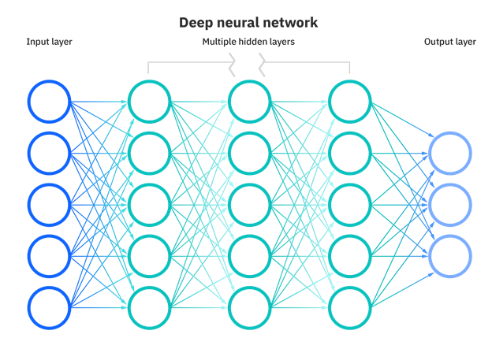
Model Architecture
Developed a Transformer Model with:
Input embedding layer
Positional encoding
Transformer encoder (4 layers, 8 heads)
Output classification layers
Training Strategy:
Weighted loss function for class imbalance
Mixed precision training for performance
Learning rate scheduling
Model selection based on validation F1 score

Slide 9
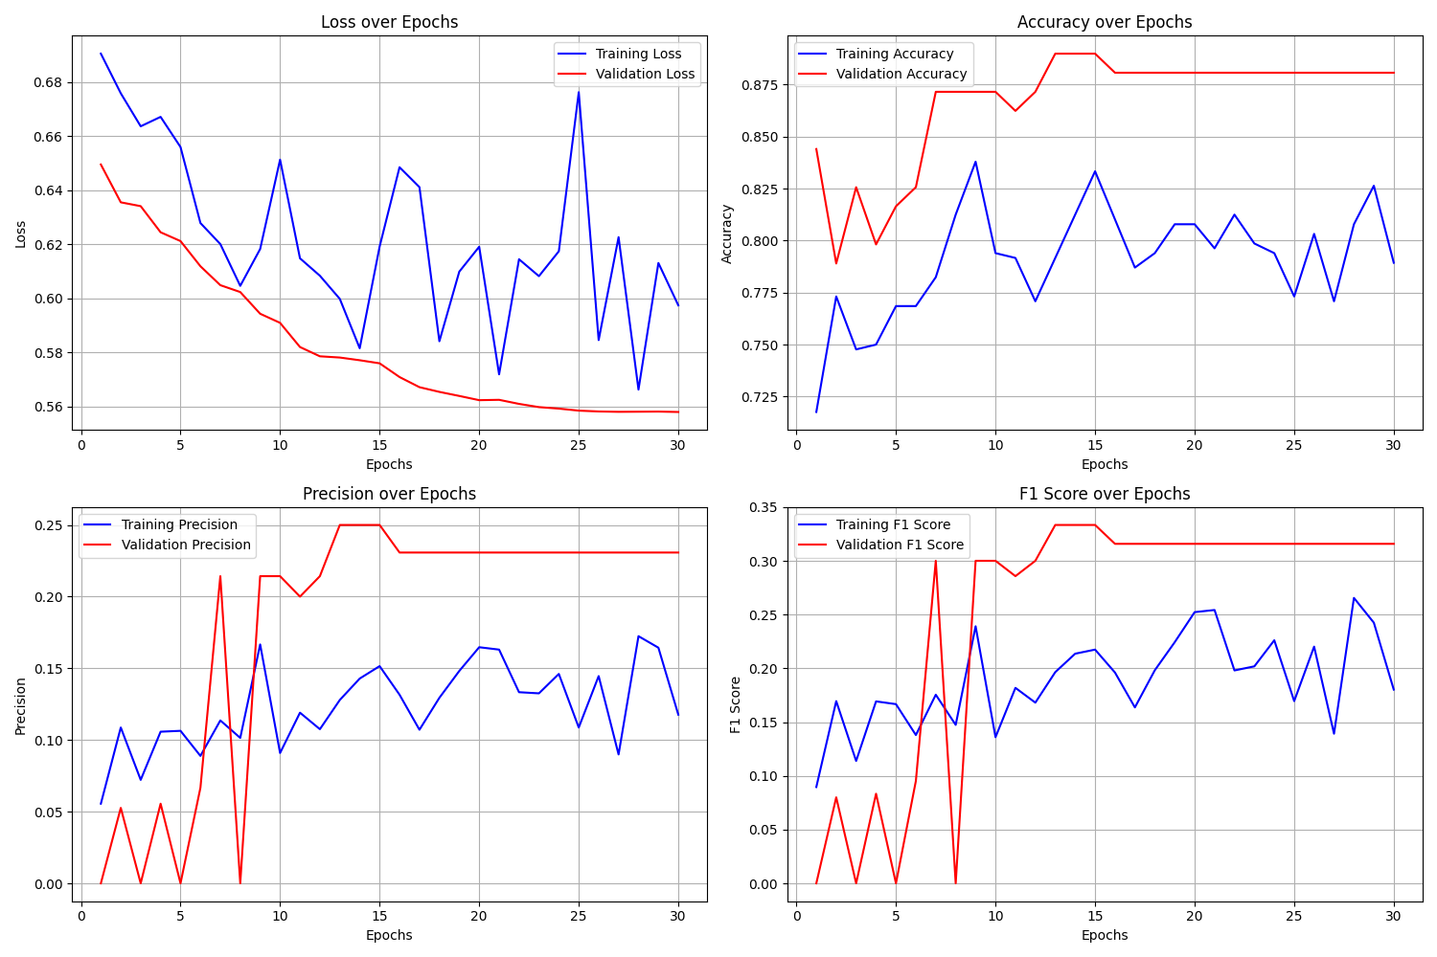
Results and discussion
While the results are not good, this shows the potential in using prediction to identify some of the main predictors of UTIs in SGLT2 patients.
The reason the results were not great, even though validation accuracy improved over the epochs, is the lack of data showing UTI development in SGLT2 patients in the MIMIC-IV dataset. This could be either due to underreporting or poor follow-ups following SGLT2 Inhibitor Therapy.
Given a bigger dataset with more patients who have developed UTIs, which seems common in SGLT2 patients according to medical research, this model could yield much better results.

